Slide 1
Notes:
As Dov has explained, we knew by 1990 that something new and potentially interesting was going on. People were converging on this thing from a lot of different directions. Some of us like Ken Salisbury from robotics, some like Tom Sheridan’s students from telemanipulation, some like Margaret Minsky from new media, some like Nat Durlach Hong Tan from communications (e.g., fo the blind), and some, like Srini, from mechanics and neuroscience. At the time, Dov and I came from a lab at MIT that was closely tied to the Dynamic Systems and Control community, and we used to attend a sizeable meeting of the DSCD at the ASME’s Winter Annual Meeting.

Slide 2
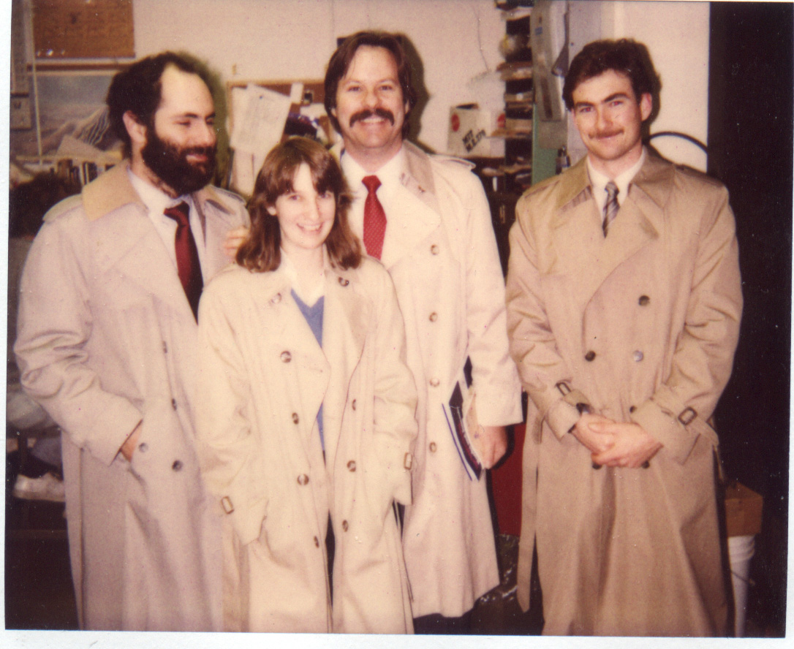
ASME Winter Annual Meeting, Boston 1987
Notes:
Here is a picture of us in the late eighties headed off to a Winter Annual Meeting when it happened to be located in Boston. We’re there with Dov’s lovely wife Laura and our labmate Bill Murray. As you can see, I was no match for either Dov or Bill when it came to facial hair. Now I’m no match when it comes to hair in general.
It was pretty ordinary for young people to organize themed sessions, we were young people, so we decided to do exactly that. We called up our friends, I assume we distributed some sort of call for papers (how’d we do that Dov, Pony Express?), and we got a few takers.

Slide 3
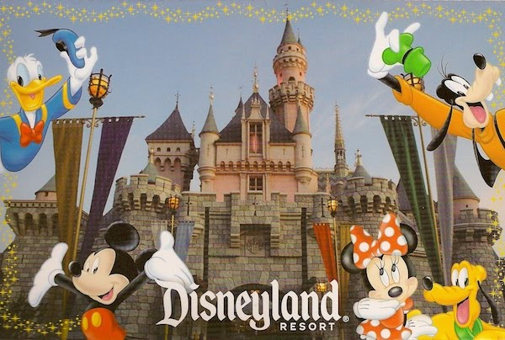
Anaheim, 1992
Notes:
That very first symposium was held in Anaheim, California (best known at the home of Disneyland, one of the happiest places on Earth) and we had nine papers.

Slide 4
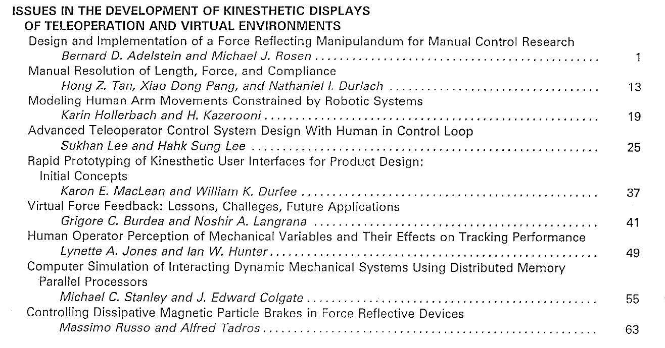
1992
Notes:
xxxxxxx
That particular paper of mine didn’t really stand the test of time. According to Google, it’s number 93 on my list of most cited papers with 7 citations. That’s one of good things about being the organizer, I guess…
Now you’ve got to understand that this was just a session, or a couple of sessions, at a big ASME conference. No banquet, no demos, no posters. But somehow I guess it was enough of a success that we decided to do it again. In the second year, we changed the name. You see, that first year the name had been Issues in the Development of Kinesthetic Displays of Teleoperation and Virtual Environments.

Slide 5
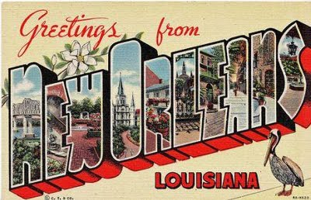
Anaheim, 1992
New Orleans 1993
Notes:
IMECE

Slide 6
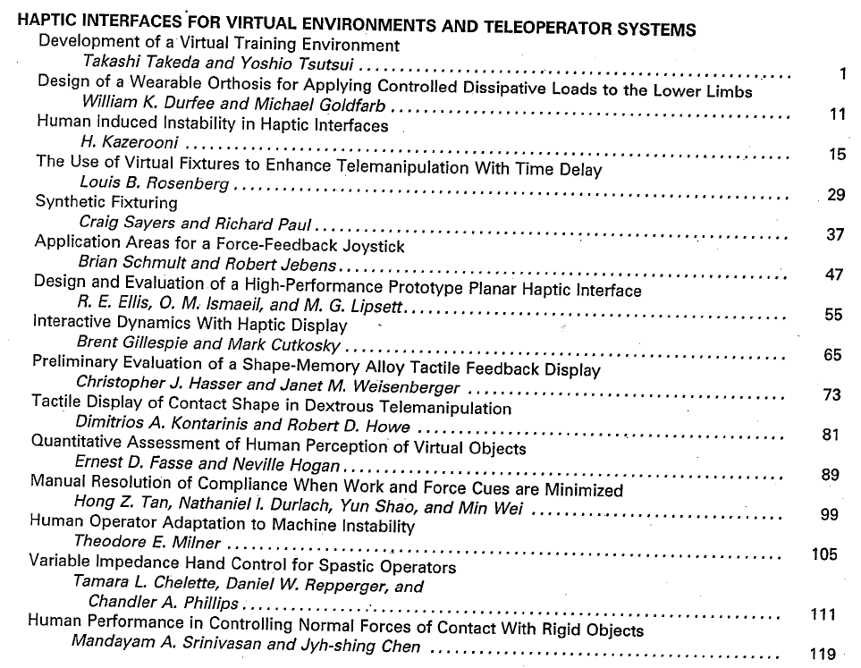
Notes:
One of the exciting things about the second year is that we got even broader participation. For instance, one of the speakers was a Stanford grad student by the name of Louis Rosenberg who would go on to found Immersion Corporation.
In the first year, the word haptic simply didn’t appear. Not in the title of the symposium, not in the title of any paper. I’m not sure if I even knew the word at that time. What is remarkable is the difference that a year made. In 93, we had changed the name to Haptic Interfaces for Virtual Environment and Teleoperator Systems

Slide 7
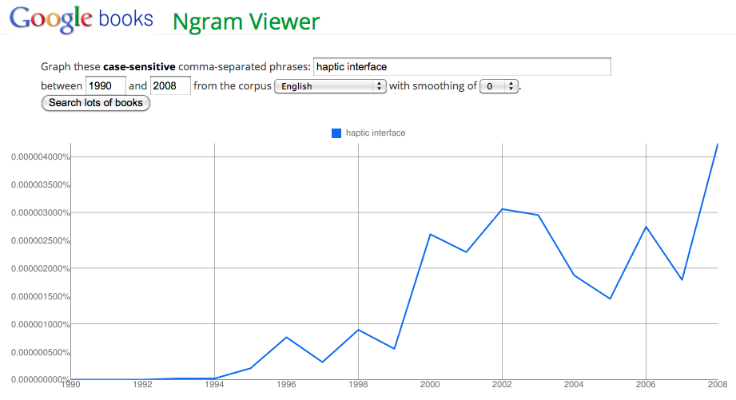
Notes:
The phrase “haptic interface” simple didn’t exist in 1992. I want to impress on you not just the fact that the phrase was created around this time, but just how critical it was for the eventual success of the field.
Just as Lederman and Klatzky showed that you can reach out and touch a banana and know nearly instantly that it is a banana – in other words that the concept of banana encapsulates some extremely complex kinesthetic and tactile information, the phrase “haptic interface” beautiful encapsulated the different things that many of us had begun to work on. It was the mot juste for our field.

Slide 8
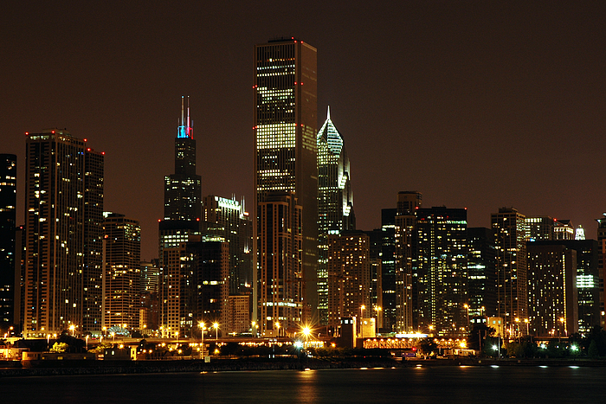
Anaheim, 1992
Chicago 1994
New Orleans 1993
Notes:
In 1994, the third Haptics Symposium was held in Chicago. We held an open house in my lab, which was very exciting.

Slide 9
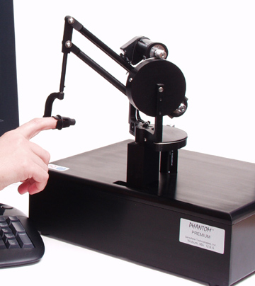
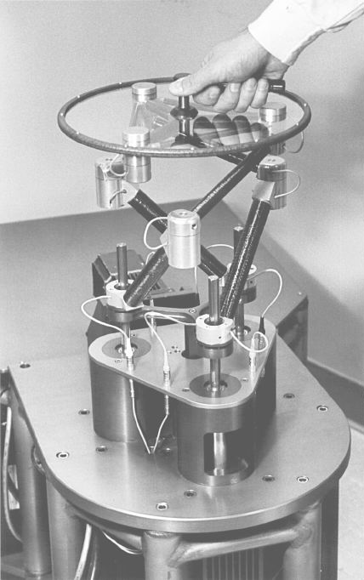
Notes:
I was particularly excited to show off our latest haptic interface [show pic] that I thought had some pretty impressive performance specs. I remember that a young MIT student wandered into the lab and expressed interest. I had heard his name and a bit about his work, but I didn’t think that much of it until the next day at the symposium. Thomas Massie gave a talk entitled “The phantom haptic interface: A device for probing virtual objects” . The accompanying paper remains the most highly cited paper in the history of the Haptics Symposium. In fact, if you do a Google Scholar search on “haptic,” it comes in at #2 behind the Ernst and Banks paper in Nature that I’m sure you all know. Not bad company.

Slide 10
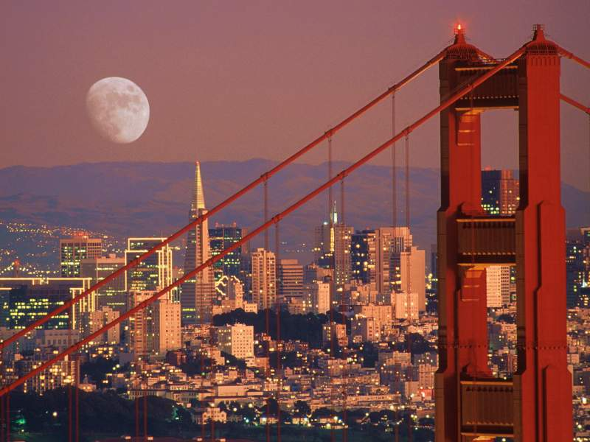
San Francisco 1995
Anaheim, 1992
Chicago 1994
New Orleans 1993
Notes:
By the fourth year we had really quite broad participation. By this time, people like Srini, Rob Howe, Blake Hannaford and Tim Salcudean in addition to names that you already saw, were regular participants. Also in our fourth year Susan and Bobby had their first paper in the Symposium, which turned out to be fateful.
Because you see, at the time, Dov and I were getting a little burned out. It was time to make a decision.

Slide 11
Decisions
Notes:
Now, the history of the Haptic Symposium is really a history of decisions. I suppose that is true of all of us: decisions of what to study, where to live, whom to marry, etc. Perhaps the first big decision had been to put together the symposium at all, and the second to continue it, but I’d say that the biggest decision we made, certainly the most fateful, was to hand it over.
Succeeding in that hand-over did a lot to ensure the longevity of the symposium. The symposium could easily have been our little extracurricular that went away as soon as we got bored. Instead, other people came in and started to take ownership. Making that handoff ensured that the symposium was owned by the haptics community, not by Dov and myself.

Slide 12
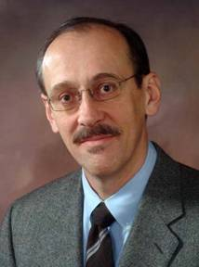
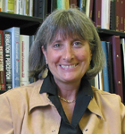
Susan Lederman
Rob Howe
Notes:
And we were incredibly fortunate in whom we got to take over: Rob Howe and Susan Lederman. We couldn’t have found two people of higher stature and more energy. Susan in particular has to be commended because an ASME conference was definitely not her home turf. But she committed not only to attending, but to organizing. That says a lot about her character.
And the results were immediate. Whereas we had been running at about 15 papers each year, under Susan and Rob the numbers jumped to 25-30.

Slide 13
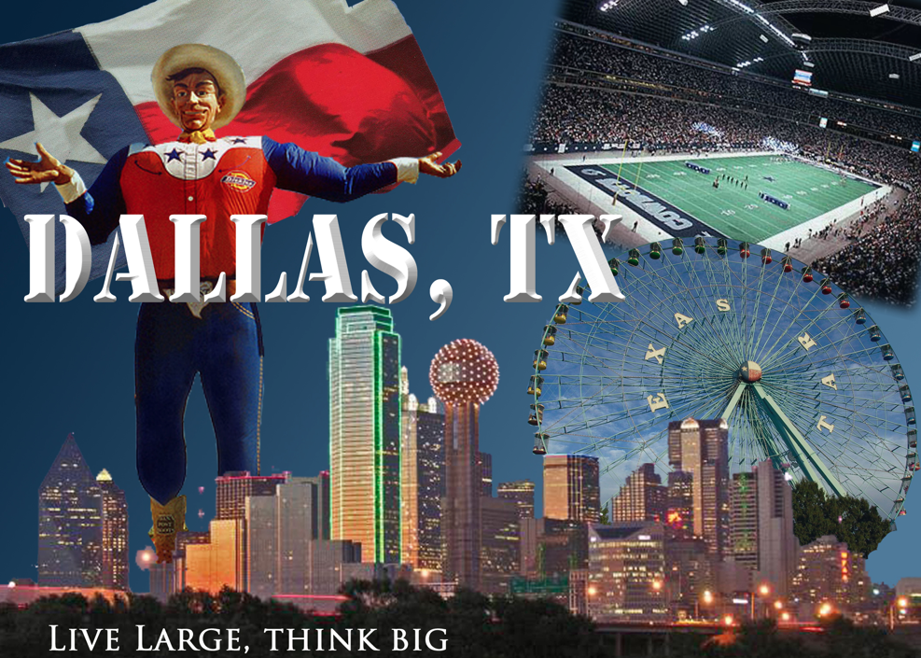
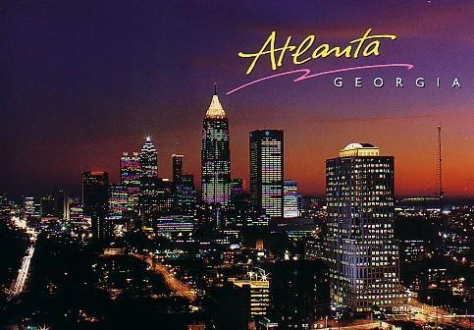
Dallas 1997
San Francisco 1995
Anaheim, 1992
Anaheim, 1998
Chicago 1994
New Orleans 1993
Atlanta 1996

Slide 14
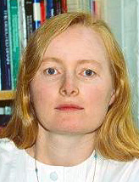
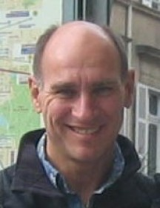
Lynette Jones
Tim Salcudean
Notes:
They ran it for three years and then handed it off to Lynette Jones and Tim Salcudean, who grew it even further, reaching the ~36 papers value that remains our sweet spot today.

Slide 15
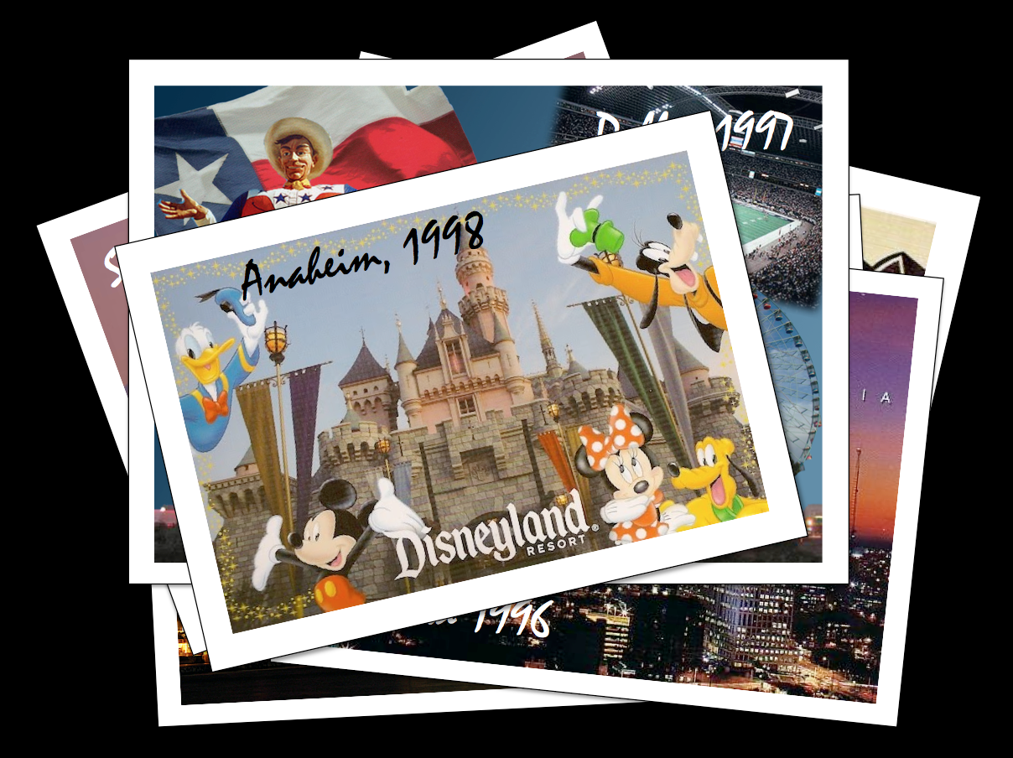
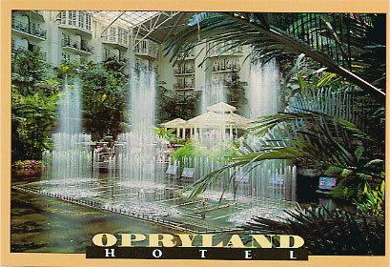
Nashville 1999
Notes:
Now, Lynette and Tim weren’t as fortunate with venues. Their very first year it was in the Opryland Hotel. If you’ve never been, it is a most remarkable structure. A Texas-sized (well, Nashville-sized) Crystal Palace full of glass panels and expansive atria. I didn’t attend that year, but I’ve had the pleasure of being there under different circumstances. understand that one needs to take boats on an indoor river to get from place to place. The thing about Opryland is that it feels, well, artificial. Nashville is an amazing slice of American culture, but it feels kind of hard to experience from the confines of Opryland.
My understanding is that this is when serious discussions of moving away from the ASME first began. Again, I have to emphasize the sheer size of the IMECE. That really forced the hand of the ASME in picking venues. They had to be big enough. Moreover, there is a tendency to get lost in the bureaucracy, and Lynette and Tim certainly suffered their share of snafus.
Unfortunately, things didn’t get any more real the following year when the meeting was held at the Dolphin Resort in Disney World. The end had come. Meetings were held. Pros and cons were weighed, and the decision was made to align with the IEEE. Not just the IEEE, but the IEEE Virtual Reality conference. This was a much smaller conference than the IMECE, and attended by people who had good reason to be interested in haptics. And it was in the spring, which worked better for those from the pyschology community.
Of course, this meant that we had to skip a year. There just wasn’t time for us to arrange a 2001 conference. So the next Haptics Symposium was held in 2002 … ironically in Orlando again. But at least not at Disney. At a hotel in downtown Orlando which was actually kind of nice, as I recall.

Slide 16
The video of this page is deleted by the request of Ed Colgate because of the copyright.
Instead, please watch the video of Ed’s retrospective talk to see what was presented here.

Slide 17
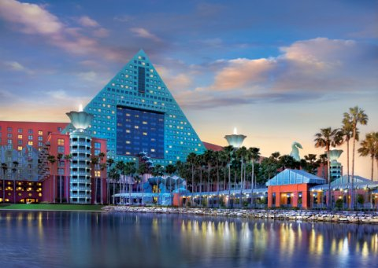
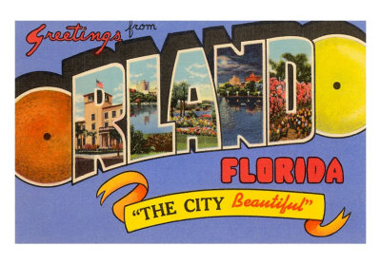
Orlando 2000
Nashville 1999
Orlando 2002
Notes:
Now, Lynette and Tim weren’t as fortunate with venues. Their very first year it was in the Opryland Hotel. If you’ve never been, it is a most remarkable structure. A Texas-sized (well, Nashville-sized) Crystal Palace full of glass panels and expansive atria. I didn’t attend that year, but I’ve had the pleasure of being there under different circumstances. understand that one needs to take boats on an indoor river to get from place to place. The thing about Opryland is that it feels, well, artificial. Nashville is an amazing slice of American culture, but it feels kind of hard to experience from the confines of Opryland.
My understanding is that this is when serious discussions of moving away from the ASME first began. Again, I have to emphasize the sheer size of the IMECE. That really forced the hand of the ASME in picking venues. They had to be big enough. Moreover, there is a tendency to get lost in the bureaucracy, and Lynette and Tim certainly suffered their share of snafus.
Unfortunately, things didn’t get any more real the following year when the meeting was held at the Dolphin Resort in Disney World. The end had come. Meetings were held. Pros and cons were weighed, and the decision was made to align with the IEEE. Not just the IEEE, but the IEEE Virtual Reality conference. This was a much smaller conference than the IMECE, and attended by people who had good reason to be interested in haptics. And it was in the spring, which worked better for those from the pyschology community.
Of course, this meant that we had to skip a year. There just wasn’t time for us to arrange a 2001 conference. So the next Haptics Symposium was held in 2002 … ironically in Orlando again. But at least not at Disney. At a hotel in downtown Orlando which was actually kind of nice, as I recall.

Slide 18
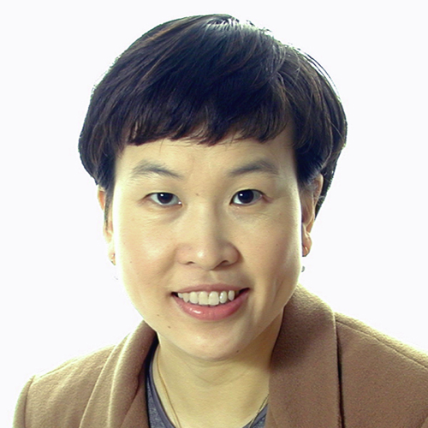
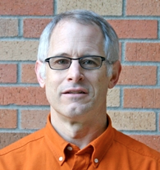
Hong Tan
Blake Hannaford
Notes:
The next team of co-chairs to run the conference was Hong Tan and Blake Hannaford.

Slide 19
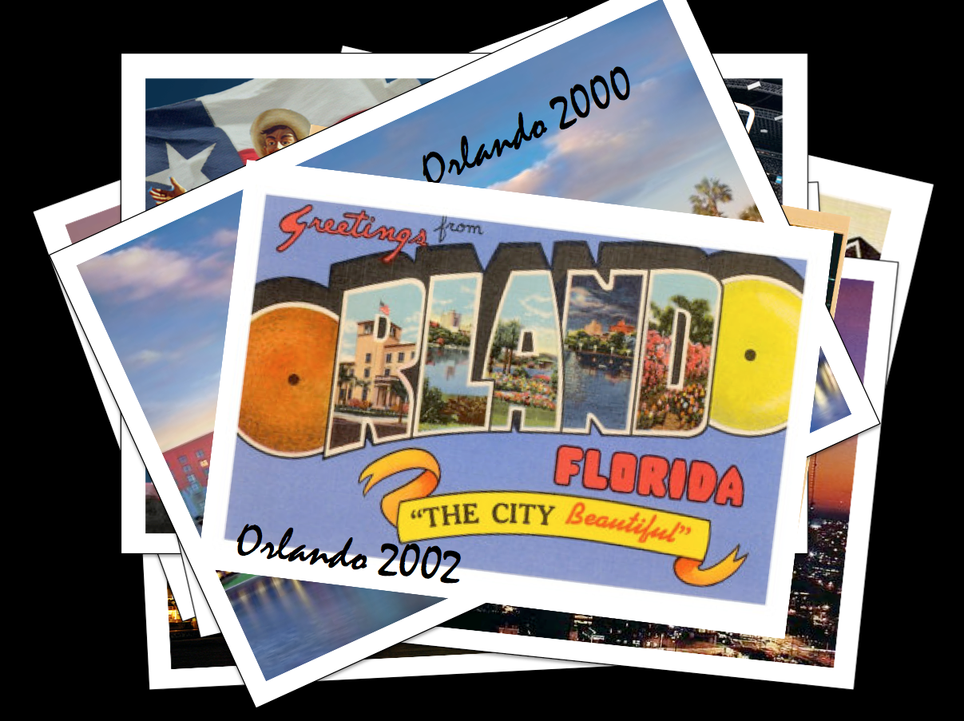
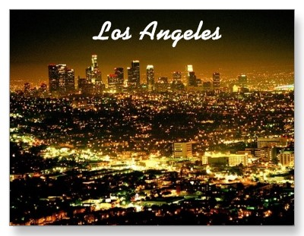
2003
Notes:
And the conference was in LA their first year. Now, around this time, the social aspects were becoming more important. In particular, it was becoming a tradition to get all of the participants together for a dinner.

Slide 20
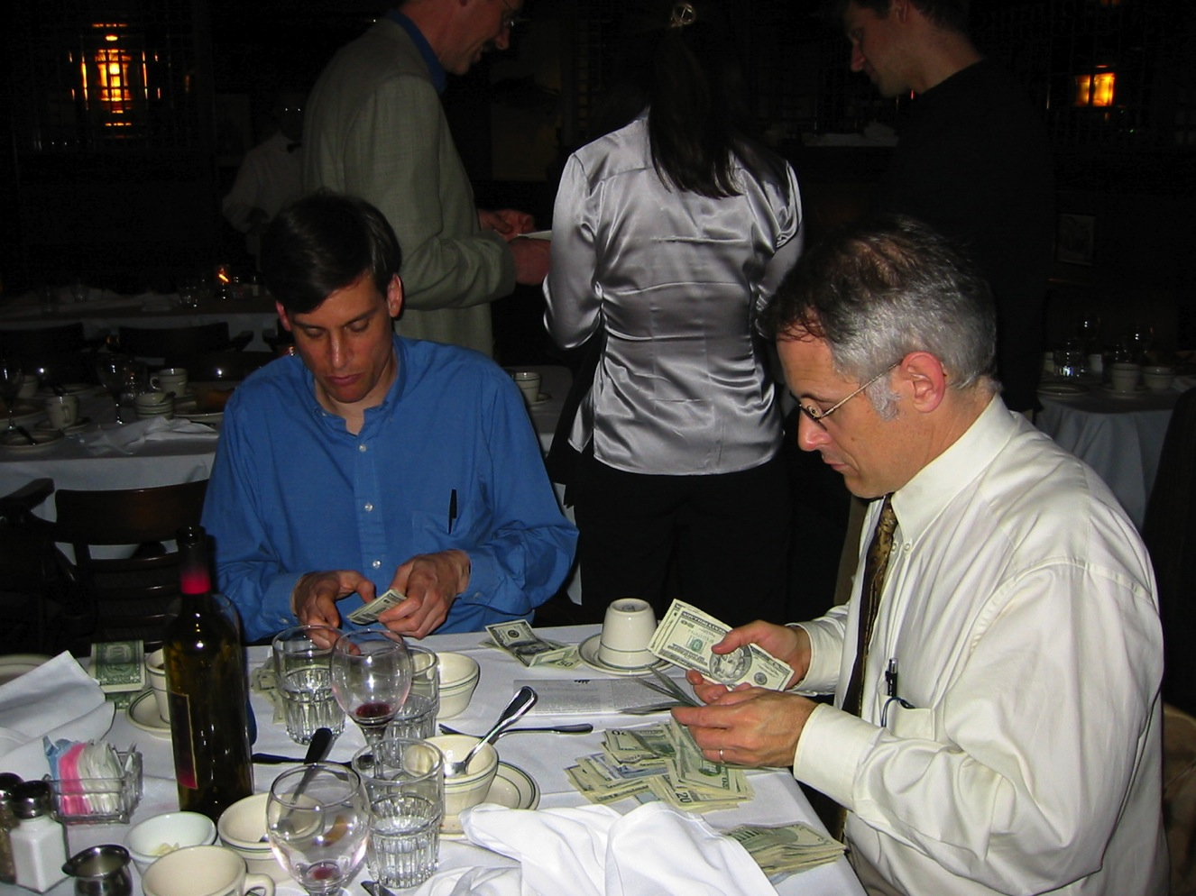
Notes:
But this was still something of an informal affair, and it sometimes resulted in the the organizer asking people to pony up when the bill came. Here’s Blake wondering where his green eyeshade went.

Slide 21
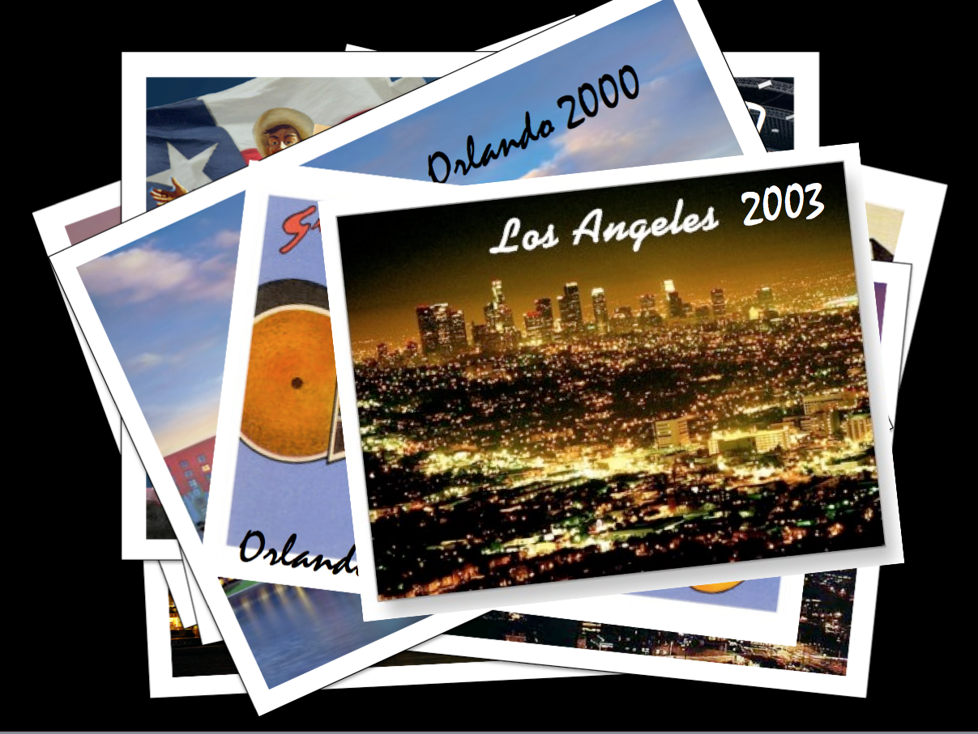
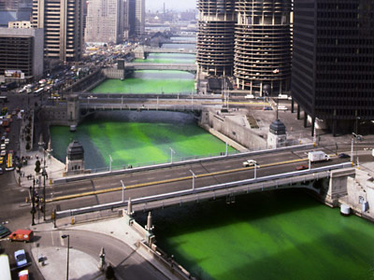
Chicago 2004
Notes:
Speaking of green, the conference came back to Chicago in 2004. Green is the color of our river on St Patrick’s day. I remember this meeting mainly because I was in charge of the dinner. I think this was the first year that we actually built the dinner into the registration. We had our own room downstairs at Maggianos. Very swank.
But things were about to change much more dramatically. In preparing this talk, I asked some folks for reminiscences, and this is what I got from Antonio Bicchi:
“I remember the night in Chicago at HS (2003? 2004?) when Hong Tan and I were resenting the fragmentation in small regional and disciplinary conferences, and we came up with a lament - dammit, what we 'd need is a WORLD haptics!”

Slide 22
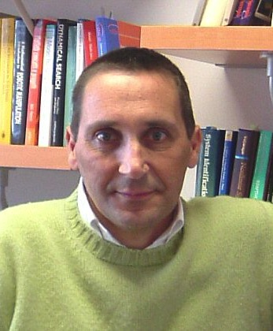
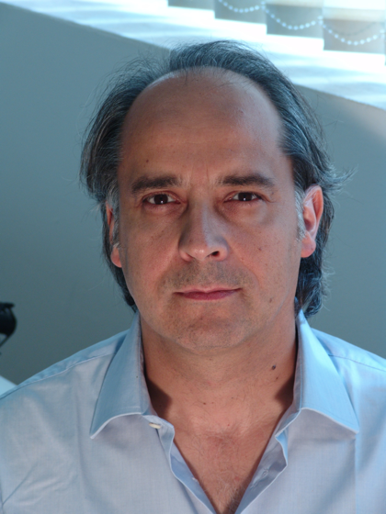
Antonio Bicchi
Massimo Bergamasco
Notes:
Indeed, that is what happened the very next year. Antonio and Massimo Bergamasco organized the very first world hapitcs conference in Pisa

Slide 23
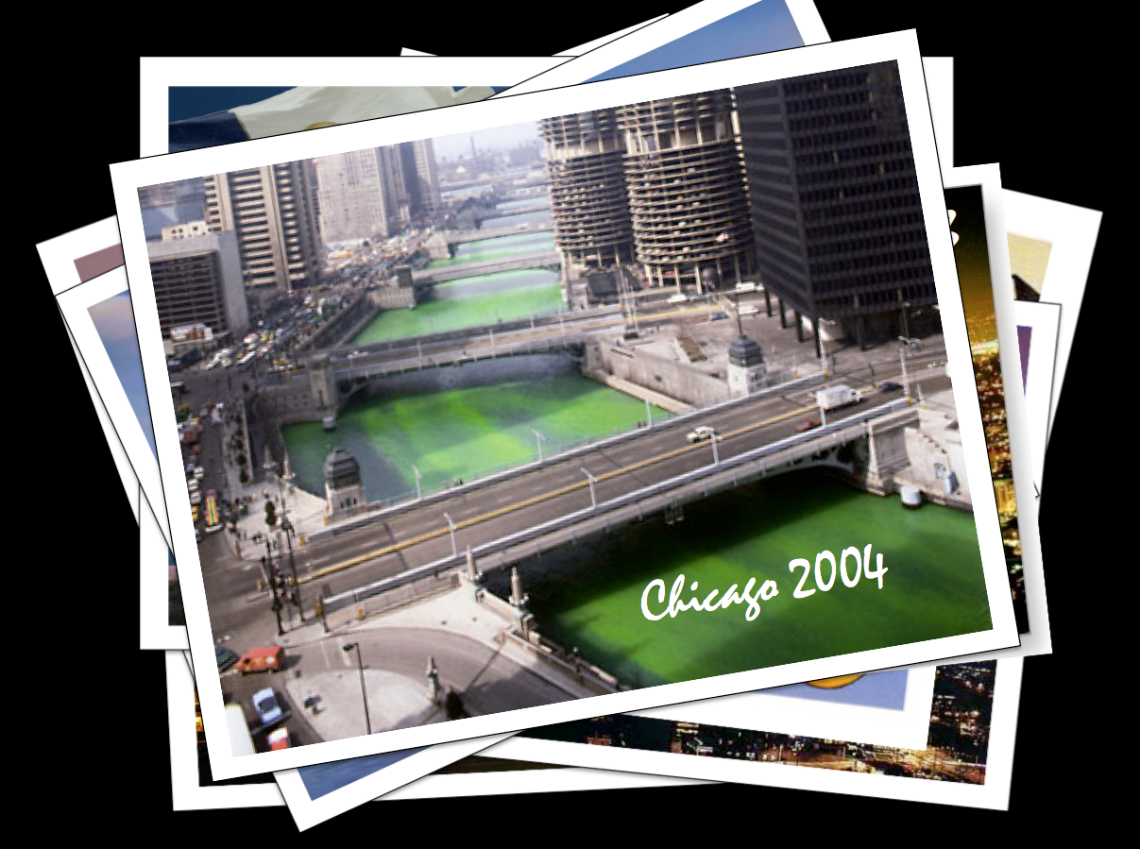
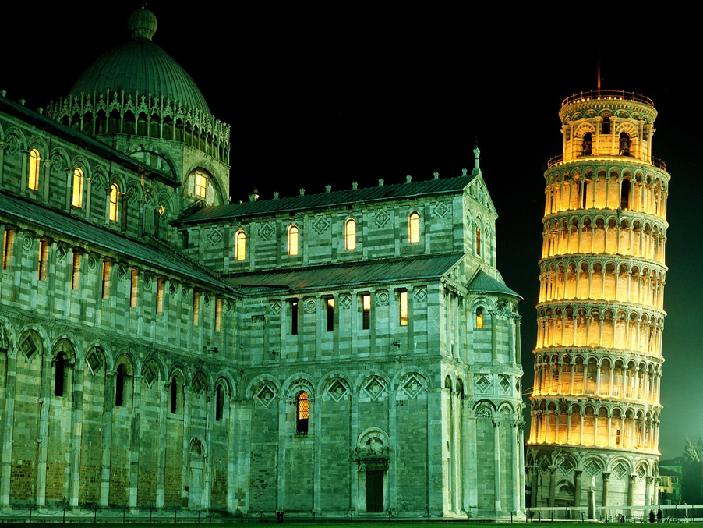
Pisa 2005
Notes:
To this day it may be the largest haptics conference ever held. 69 papers and 143 posters. It was huge!

Slide 24
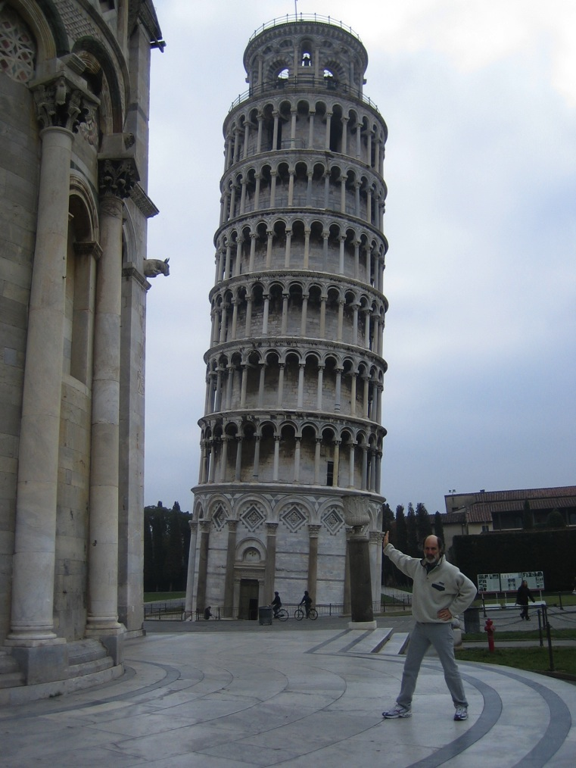
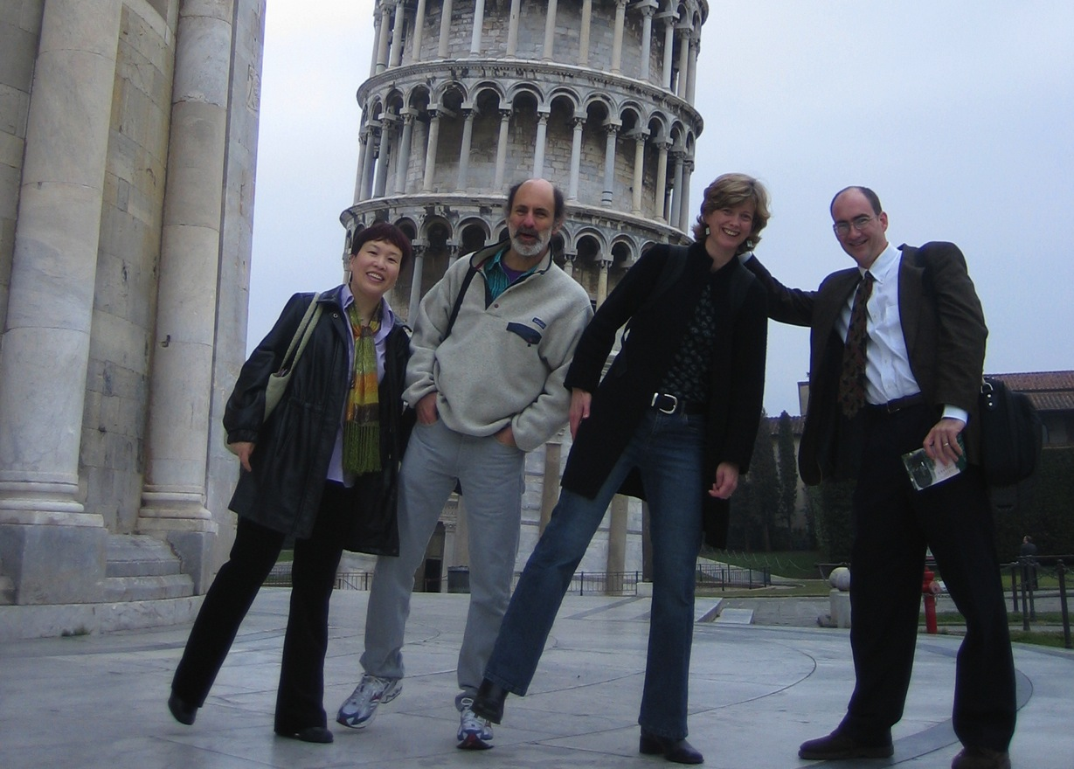
Notes:
But it was also a great opportunity for us North Americans to help out our European friends. Here Dov shores up the tower. Its power to cause leaning, however, is impressive. Eventually, I had to step in to support Hong, Dov and Karon.

Slide 25
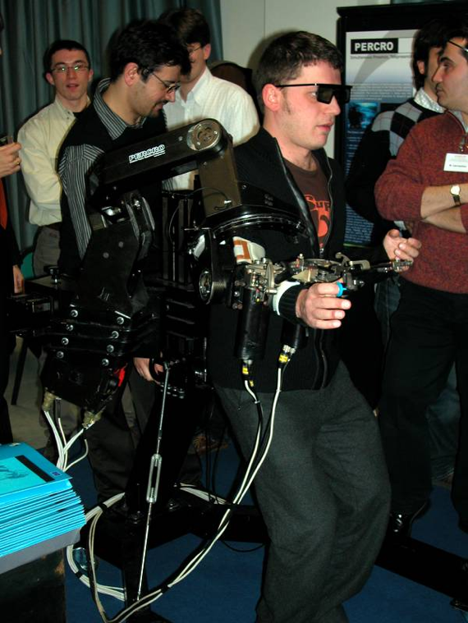
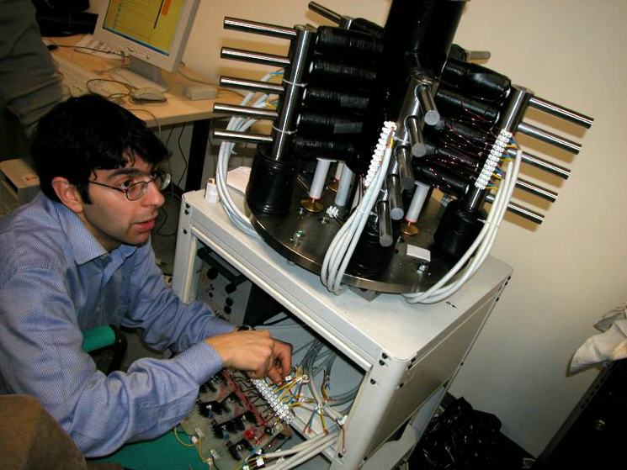
Notes:
One of the things that a lot of us remember about Pisa is the scope and the quality of the demos. We had had demos before, but World Haptics took them to a new level

Slide 26
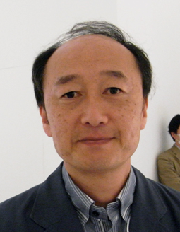
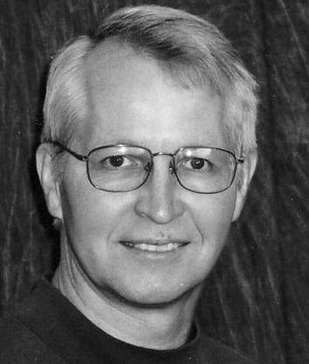
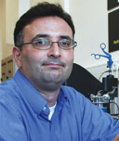
Hiroo Iwata
Cagatay Basdogan
John Hollerbach
Notes:
Now I’m going to break out of the strict chronology and say just a little bit about the three World Haptics conferences that have followed. They were organized by these men…

Slide 27
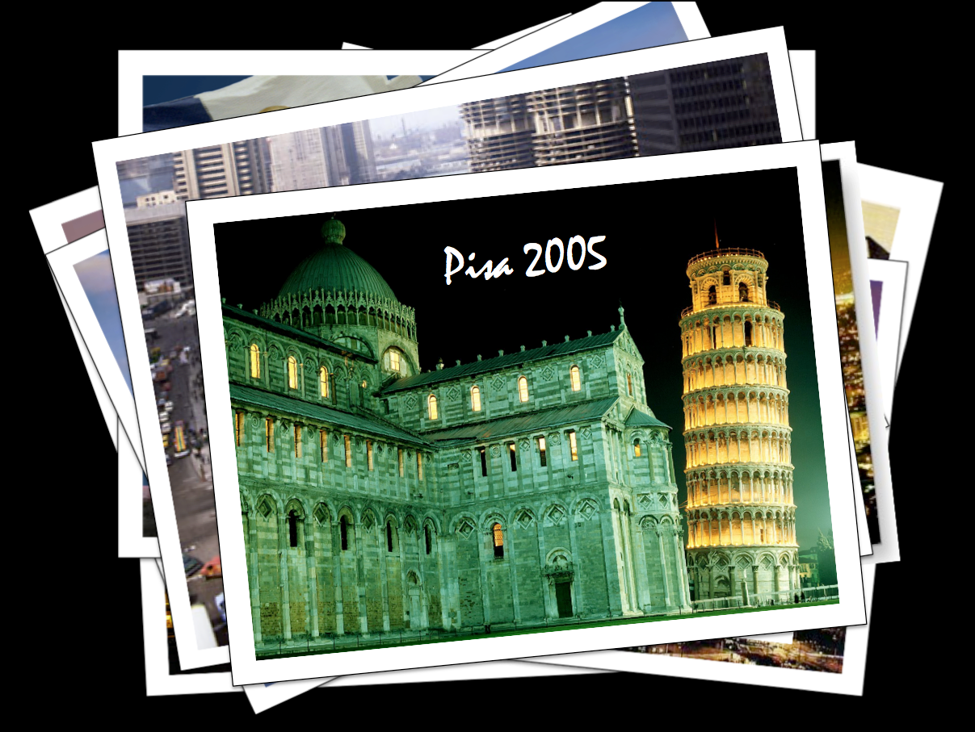
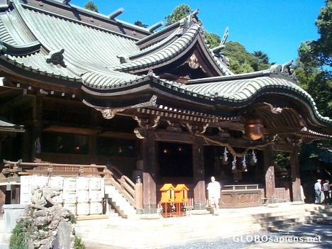
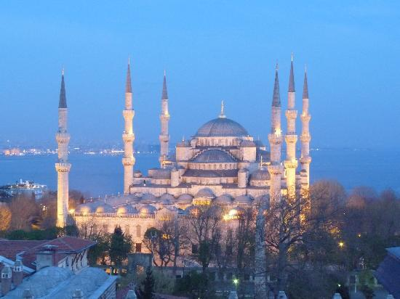
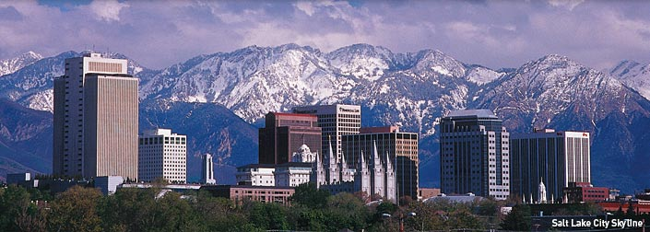
Istanbul 2011
Salt Lake City 2009
Tsukuba 2007
Notes:
And held in Tsukuba Japan, Salt Lake City and Istanbul. Every one of these was an outstanding event, widely appreciated by the haptics community for the breadth and quality of the work presented….

Slide 28
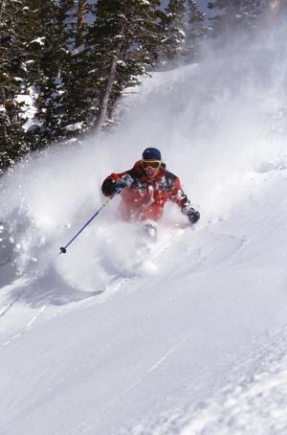
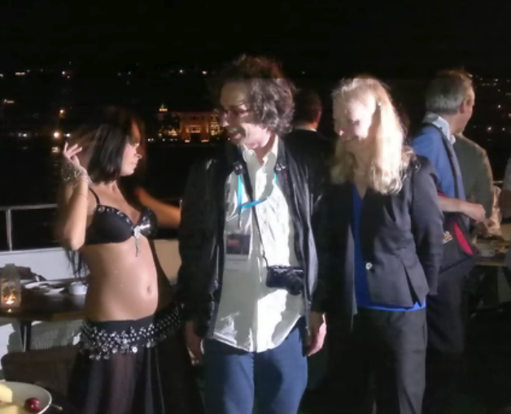
Notes:
But also for the quality of the entertainment. For instance, John Hollerbach’s sons had a musical group that performed at the banquet and I believe that this was the very first haptics conference featuring dancing. But Cagatay was not to be outdone, especially in the dancing department. I have to say that I really like this photo…

Slide 29
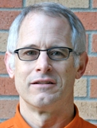
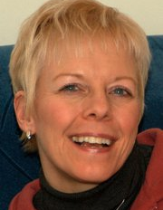
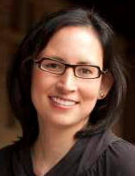
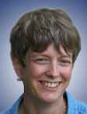
Blake Hannaford
&
Jan Weisenberger
Jan Weisenberger
&
Allison Okamura
Allison Okamura
&
Karon Maclean
Notes:
Meanwhile, the haptics symposium continued in even years, and started the sensible tradition of staggered co-chairs.

Slide 30
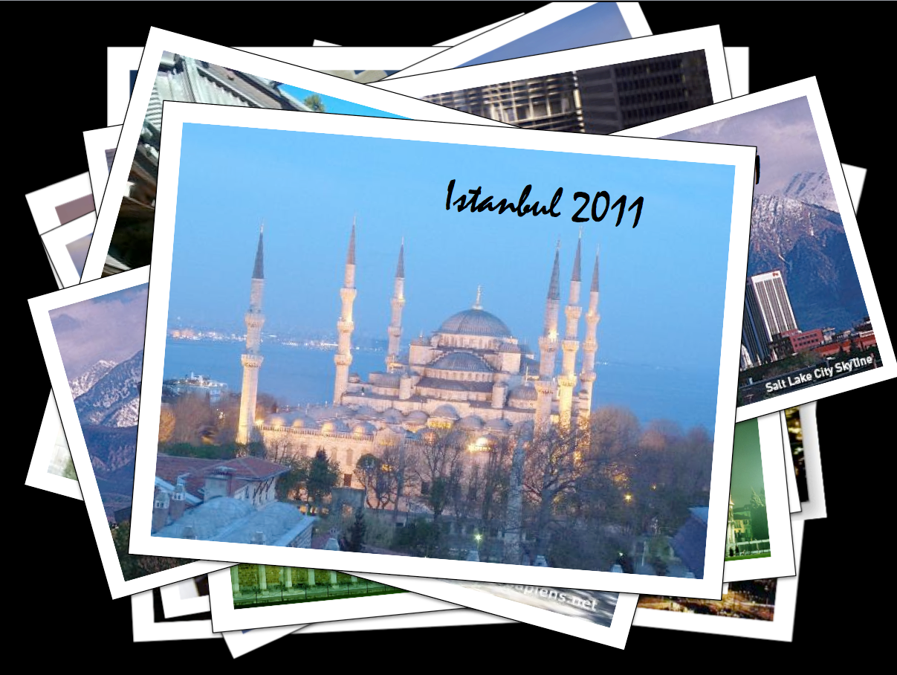
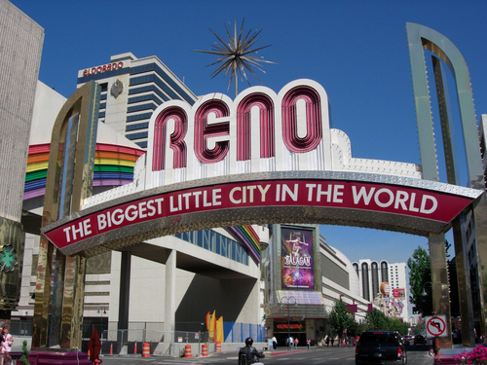


Reno 2008
Arlington, VA 2006
Waltham 2010
Notes:
Recent venues have included Arlington VA (this is the view from Arlington, looking across the Potomac), Reno and Walham Massachusetts. This is the view from Waltham, assuming one is in a hot air balloon with a telescope. So, the venues weren’t really the greatest.

Slide 31






Notes:
But the conferences were still awesome, with amazing demos and some pretty excellent entertainment, such as a night at the Boston Museum and Science. Nonetheless, discontent with the venues and struggles with the IEEE VR conference were growing. And what better place to declare independence than Boston!

Slide 32

Karon Maclean
Marcia O’Malley
Notes:
Which brings us to the end of this chronology and the beginning of many new adventures, I’m sure. Karon and Marcie and the entire Organizing Committee have done an outstanding job of organizing the first-ever independent Haptics Symposium. Indeed, one can honestly say that they have done an outstanding job of organizing the first ever Haptics Symposium since this is the first time that the conference has actually had that name.

Slide 33


Vancouver 2012
Notes:
So here we are in Vancouver.

Slide 34
How has it changed?
Where is it going?
Notes:
Well, I’ve eaten up all of my time rehashing old history but I bet what you really wanted to know if how has the field changed, and where is it going? Understanding that one can only fail when trying to answer questions like these, let me take a stab..

Slide 35
(p<0.05)
Notes:
To get some insights into the change, I spent some time going through the 1993 proceedings. There were 15 papers and 12 of them reported some type of human subject experiments. In two cases the subject was clearly the lead author. Two papers mentioned “subjects” (plural) but never the number of subjects. One had 15 subjects, Two had 8 subjects while the next most reported was 3. Six papers showed error bars and one used the phrase “statistically significant,” but only one of them reported a p value. And the authors were no slouches. People like Jan Weisenberger, Hong Tan, Rob Howe and Srini. It just wasn’t part of the culture of this particular conference. But it was a bit more than that, I think. It was partly the result of a sort of device orientation. While a couple of papers were actually explicitly about human capabilities, the main focus was on examining the performance of devices.
Of course, things have changed now. I call this the rise of p, and yes, it is statistically significant. The stats are just much stronger today. But the change is really something much deeper than better statistics. It is really a recognition that the engineering of haptic interfaces and the science of haptic perception are deeply coupled. Elegant display technology is never about veridical representation of the real world. That’s just a story we engineers tell ourselves. Consider the difference between a picture snapped with a digital camera and an Ansel Adams masterpiece. At 14 megapixels and xxx bit color depth, the digital camera shot will arguably be more veridical. But the Adams photo is greater because he had a deep understanding of, well, perception. And so it is with haptics. In the early days you had people like me striving for passivity and Z-width, trying to recreate the world and ignoring, to the best of my ability, the human. Today you’ve got a new generation of researchers who are asking much more elegant questions
So the rise of p… it’s not probability, it’s perception.

Slide 36


Notes:
I call this “Sunset, Chicago Illinois”. Ansel Adams called this “Moonrise, Hernandez, New Mexico”
I was going to speak about these a bit differently, but I realize this is just another example of what Desney Tan talked about yesterday: invention, emulation and maturity, concepts he attributed to Randy Pausch. Amateur photographers like me are stuck in the emulation mode. I see the a pretty scene and want to capture it faithfully. Ansel Adams was mature. He understood his medium, and also human perception, at a much deeper level. He was able to capture something about his world, to create meaning.
I think what I’ve seen in the past 20 years is a maturing of the field. 20 years ago it was all about emulation. I tried to build devices with large z-width so that they could faithfully represent the state of the world and Hong tried to measure JNDs so that we would understand just how faithful devices needed to be. But we weren’t looking beyond these things to perception, really. Today were are closer. Today you’ll see people thinking about haptic aesthetics, about illusions, and even delight. You’ll see that the palette has expanded far beyond kinesthetic feedback.
The medium hasn’t reached the point that an Ansel Adams can emerge, but it’s on the way.
Illusions, aesthetics, delight

Slide 37
HCI
Application and Markets
Engineering
Psychology
Neuroscience
Notes:
Remember Desney’s rule of 20 years

Slide 38
Acknowledgements
Marcia O’Malley, Karon Maclean
Hong Tan, Lynette Jones, Antonio Bicchi, Tim Salcudean, Hiroo Iwata, Mandayam Srinivasan, Katherine Kuchenbecker, Seugmoon Choi
Joe Mullenbach

